Slide 1
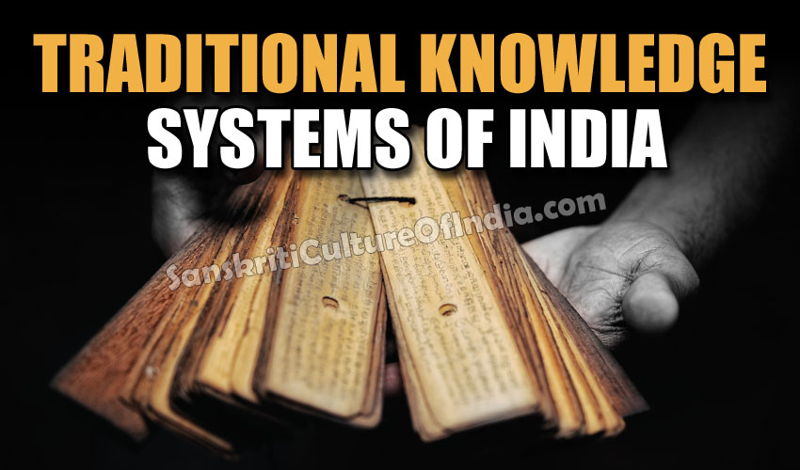
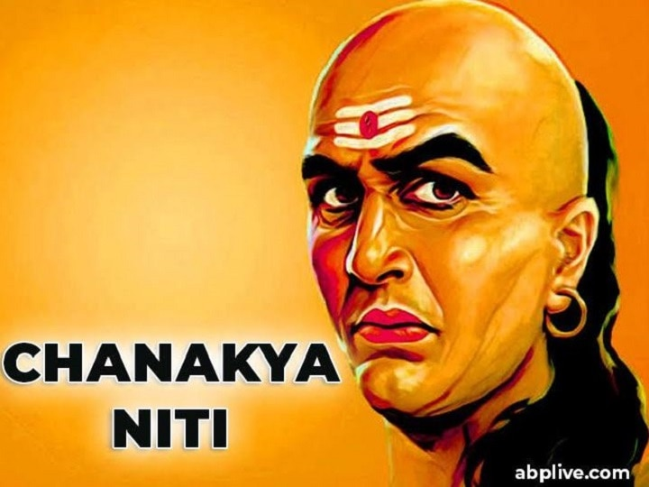


Essence of Indian Traditional Knowledge
Jay Acharya
B.E. (Prod)
MHRDM
2020 . All rights reserved. For internal client use only.

Slide 2
Essence of Indian Traditional Knowledge
WATCH THIS VIDEO and answer the following questions –
What is the essence of this video
What do you observe in this video?
How does it appeal to you?
2020 . All rights reserved. For internal client use only.

Slide 3
Let’s talk about Indian Movies -
Rang de basanti - https://www.youtube.com/watch?v=QHhnhqxB4E8
Jodha Akbar - https://www.youtube.com/watch?v=Ce-rrik4kT4
Mohenjo Daro - https://www.youtube.com/watch?v=UPZ5FKEB02I
Bahubali - https://www.youtube.com/watch?v=G62HrubdD6o
Lagaani - https://www.youtube.com/watch?v=LQmHKl3oNu0
Can you see a common thread connecting these videos ?
2020 . All rights reserved. For internal client use only.

Slide 4
What do you see behind the scenes ? -
Rang de basanti - Indian History – The struggle for Independence – Connecting Indian Youth to our Leaders
Jodha Akbar – Mughal History
Mohenjo Daro – Pre-medival India – The beginning of Indus Civilization
Bahubali – Fiction with a flavour of Indian History
Lagaan – Indian History with a flovour of fiction
Can you see a common thread connecting these movies ?
2020 . All rights reserved. For internal client use only.

Slide 5


Essence of Indian Traditional Knowledge
What is the Common Thread?
INDIAN TRADITION...
All these movies give a glimpse of INDIAN TRADITION
2020 . All rights reserved. For internal client use only.

Slide 6
Essence of Indian Traditional Knowledge
Course Objectives and Outcomes
Objectives:
This course provides introduction to Indian traditional knowledge and its relevance in the modern society.
Course Outcomes:
After completion of the course, students would be able to:
Understand the concept of Traditional knowledge and its importance
Apply the concept of Vedic mathematics to solve problems
Understand relevance of Chanakya niti in modern management
2020 . All rights reserved. For internal client use only.

Slide 7
Essence of Indian Traditional Knowledge
What is TRADITION?
As per the Oxford Dictionary -
a belief, custom, or way of doing something that has existed for a long time among a particular group of people; a set of these beliefs or customs religious/cultural, etc.
2020 . All rights reserved. For internal client use only.

Slide 8
Essence of Indian Traditional Knowledge
What is TRADITIONAL KNOWLEDGE ?
As per WIPO (World Intellectual Property Organisation)
Traditional knowledge (TK) is knowledge, know-how, skills and practices that are developed, sustained and passed on from generation to generation within a community, often forming part of its cultural or spiritual identity.
https://www.youtube.com/watch?v=14YInJGNwZc
2020 . All rights reserved. For internal client use only.

Slide 9
Course Syllabus
Introduction to traditional knowledge – 5 hrs
Define traditional knowledge, nature and characteristics, scope and importance,
kinds of traditional knowledge,
the physical and social contexts in which traditional knowledge develop,
the historical impact of social change on traditional knowledge systems.
Indigenous Knowledge (IK), characteristics,
traditional knowledge vis-à-vis indigenous knowledge,
traditional knowledge Vs western knowledge
traditional knowledge vis-à-vis formal knowledge
Essence of Indian Traditional Knowledge
2020 . All rights reserved. For internal client use only.

Slide 10
Course Syllabus
Traditional knowledge in different sectors – 5 hrs
Traditional knowledge and engineering,
Traditional medicine system,
TK and biotechnology,
TK in agriculture, traditional societies depend on it for their food and healthcare needs,
Importance of conservation and sustainable development of environment,
Management of biodiversity, Food security of the country
Protection of TK.
Essence of Indian Traditional Knowledge
2020 . All rights reserved. For internal client use only.

Slide 11
Course Syllabus
Vedic mathematics – 5 hrs
Introduction,
subtraction,
multiplication,
division,
linear and quadratic equations,
simultaneous linear equations,
factorizations
Essence of Indian Traditional Knowledge
2020 . All rights reserved. For internal client use only.

Slide 12
Course Syllabus
Vedic Management – 5 hrs
Introduction,
Framework
the 4 divisions of work
the 4 Ashramas
Putting it all together
The Vedic Corporate Management Model
Learning Outcomes
Essence of Indian Traditional Knowledge
2020 . All rights reserved. For internal client use only.

Slide 13
Course Syllabus
Chanakya and modern management – 10 hrs
Leadership,
Qualities of a leader,
People management,
Strategy,
Teamwork
Essence of Indian Traditional Knowledge

Slide 14
Essence of Indian Traditional Knowledge
TRADITIONAL KNOWLEDGE
Nature & Characteristics
A report of the International Council for Science (ICSU) Study Group on Science and Traditional Knowledge characterises traditional knowledge as:
"a cumulative body of knowledge, know-how, practices and representations maintained and developed by peoples with extended histories of interaction with the natural environment. These sophisticated sets of understandings, interpretations and meanings are part and parcel of a cultural complex that encompasses language, naming and classification systems, resource use practices, ritual, spirituality and worldview.”
2020 . All rights reserved. For internal client use only.

Slide 15
Essence of Indian Traditional Knowledge
TRADITIONAL KNOWLEDGE
Nature & Characteristics
Traditional knowledge typically distinguishes one community from another.
In some communities, it takes on personal and spiritual meanings.
It can also reflect a community's interests.
Some communities depend on their traditional knowledge for survival.
Traditional knowledge regarding the environment such as taboos, proverbs and cosmological knowledge systems provide a lot of conservation ethos for biodiversity preservation.
On the other hand, indigenous and local communities themselves may perceive traditional knowledge very differently
Many communities have clear traditions of custodianship over knowledge
Use of their traditional knowledge warrants respect and sensitivity
2020 . All rights reserved. For internal client use only.

Slide 16
Essence of Indian Traditional Knowledge
TRADITIONAL KNOWLEDGE
Scope
Traditional Knowledge (TK) is the
awareness,
experience,
expertise,
knowledge and
Applications
that are established, continued, performed and passed on from generation to generation within a region or community, often forming a part of its cultural, social or spiritual identity.
TK can be attributed to in a wide variety of contexts, viz. agricultural, scientific, technical, ecological and medicinal knowledge as well as biodiversity-related knowledge.
TK is mostly undocumented and typically inherited via word of mouth.
2020 . All rights reserved. For internal client use only.

Slide 17
Essence of Indian Traditional Knowledge
TRADITIONAL KNOWLEDGE
Importance
Bridge the gap with western science
Recognizing various local knowledge sources and using them for productive exchanges
Detecting early signs of climate change thru inclusive dialogue
Using the best available knowledge to face challenges the world is currently facing
Collaborate between primitive and progressive communities
Facilitates national policy & Decision-making
People from different places and backgrounds come together
Allows new insights and new kinds of wisdom to be merged
Integrates communities to have a better understanding of the world we live in
Exchange of knowledge and understanding
Share customs and beliefs
Facilitate collaborative research
2020 . All rights reserved. For internal client use only.

Slide 18
Essence of Indian Traditional Knowledge
TRADITIONAL KNOWLEDGE
Kinds of Traditional Knowledge
Traditional knowledge includes types
knowledge about traditional technologies of subsistence (e.g. tools and techniques
for hunting or agriculture,
midwifery,
ethnobotany and
ecological knowledge,
traditional medicine,
celestial navigation,
craft skills,
ethnoastronomy,
climate,
and others.
Watch the video and then discuss this slide
SCIENTIFIC REASONS BEHIND INDIAN TRADITIONS
TRADITIONAL DRESSING OF INDIA
2020 . All rights reserved. For internal client use only.

Slide 19
Essence of Indian Traditional Knowledge
TRADITIONAL KNOWLEDGE
ASSIGNMENT No. 1
Before the Assignment, some points to note -
This is an individual assignment. Each one of you will have to submit it individually
Time for this assignment - 2 weeks
The Assignment –
List all the traditions that your personally follow throughout the year with your family and friends.
Out of the ones you listed, identify FIVE of them that you genuinely follow for your own reasons
For each of the FIVE, write a small essay of 5 lines explaining why that tradition appeals to you?
Include your full length photograph in your traditional dress and give a short description of it’s significance
Formulate all the above in slides.
2020 . All rights reserved. For internal client use only.

Slide 20
Essence of Indian Traditional Knowledge
TRADITIONAL KNOWLEDGE
Physical & Social Context
2020 . All rights reserved. For internal client use only.

Slide 21
Essence of Indian Traditional Knowledge
TRADITIONAL KNOWLEDGE
Historical Impact of Social Change
2020 . All rights reserved. For internal client use only.

Slide 22
Essence of Indian Traditional Knowledge
TRADITIONAL KNOWLEDGE
Indigenous Knowledge
Indigenous knowledge is the unique knowledge confined to a particular culture or society.
It is also known as local knowledge, folk knowledge, people's knowledge, traditional wisdom or traditional science.
This knowledge is generated and transmitted by communities, over time, in an effort to cope with their own agroecological and socio-economic environments
It is generated through a systematic process of observing local conditions, experimenting with solutions and readapting previously identified solutions to modified environmental, socio-economic and technological situations.
Indigenous knowledge is passed from generation to generation, usually by word of mouth and cultural rituals, and has been the basis for agriculture, food preparation and conservation, health care, education, and the wide range of other activities that sustain a society and its environment in many parts of the world for many centuries.
2020 . All rights reserved. For internal client use only.

Slide 23
Essence of Indian Traditional Knowledge
TRADITIONAL KNOWLEDGE
Indigenous Knowledge - Characteristics
Indigenous knowledge is local. It is rooted to a particular place and set of experiences, and generated by people living in those places
Indigenous knowledge is orally-transmitted, or transmitted through imitation and demonstration
Indigenous knowledge is the consequence of practical engagement in everyday life, and is constantly reinforced by experience and trial and error. This experience is characteristically the product of many generations of intelligent reasoning,
it is empirical rather than theoretical knowledge.
Repetition is an essential characteristic of tradition, even when new knowledge is added.
Indigenous knowledge is constantly changing, being produced as well as reproduced, discovered as well as lost; though it is often represented as being somehow static.
2020 . All rights reserved. For internal client use only.

Slide 24
Essence of Indian Traditional Knowledge
TRADITIONAL KNOWLEDGE
Indigenous Knowledge – Characteristics contd...
Indigenous knowledge is shared to a much greater degree than other forms of knowledge.
Although indigenous knowledge may be focused on particular individuals and may achieve a degree of coherence in rituals and other symbolic constructs, its distribution is always fragmentary.
indigenous knowledge is at its densest and directly applicable its organization is essentially functional. ,
Indigenous knowledge is characteristically situated within broader cultural traditions; separating the technical from the nontechnical, the rational from the non-rational is problematic. .
2020 . All rights reserved. For internal client use only.

Slide 25
Essence of Indian Traditional Knowledge
TRADITIONAL KNOWLEDGE
Traditional Knowledge vs Indigenous Knowledge
Traditional Knowledge
Indigenous Knowledge
Traditional knowledge (TK) is knowledge, know-how, skills and practices that are developed, sustained and passed on from generation to generation within a community, often forming part of its cultural or spiritual identity.
Indigenous knowledge is the unique knowledge confined to a particular culture or society and is also known as local knowledge, folk knowledge, people's knowledge, traditional wisdom or traditional science.
2. Traditional knowledge typically distinguishes one community from another
2. Indigenous knowledge typically defines a community
3. It is generic and often found in small traces in communities.
3. It is specific to certain communities and more localized to geographies
4. It is a broader term and denotes a body of knowledge beyond historical proofs and evidences
4. It is a rather narrow term and is practiced in the form of customs and practices within a particular local community
2020 . All rights reserved. For internal client use only.

Slide 26
Essence of Indian Traditional Knowledge
TRADITIONAL KNOWLEDGE
Traditional Knowledge vs Western Knowledge
Traditional Knowledge
Western Knowledge
Traditional knowledge (TK) is generally transmitted from one generation to other through word-of-mouth
Western Knowledge is generally transmitted from one generation to other through postulates and theories
Traditional knowledge systems
adopt a more holistic approach, and do not separate observations into different disciplines
Western Knowledge is rather fragmented and presents itself through various disciplines and areas of expert knowledge
3. Traditional knowledge is mainly subjective and qualitative.
3. Western knowledge is objective and quantitative.
4. Traditional knowledge always depends on its context and particular local conditions
4. Western science isolates its objects of study from their vital context by putting them in simplified and controllable experimental environments—which also means that scientists separate themselves from nature, the object of their studies
2020 . All rights reserved. For internal client use only.

Slide 27
Essence of Indian Traditional Knowledge
TRADITIONAL KNOWLEDGE
Traditional Knowledge vs Formal Knowledge
Traditional Knowledge
Formal Knowledge
Traditional Knowledge is oriented in a way that it provides information about past and present events | Formal Knowledge is more focussed on developing the acumen of a person towards future challenges
Generally involves informal means of dissemination and distribution | Uses Formal means of communication to make the distribution acceptable
Learning is more by doing and experiencing | Learning is more through systematic methods of learning theories
It is integrated and based on the complete system | It is more Analytical, based on subsets of the whole system
It is intuitive and broad | It is hypothesis based or model based
2020 . All rights reserved. For internal client use only.

Slide 28
Essence of Indian Traditional Knowledge
Traditional knowledge
in different sectors
2020 . All rights reserved. For internal client use only.

Slide 29
Course Syllabus
Traditional knowledge in different sectors – 5 hrs
Traditional knowledge and engineering,
Traditional medicine system,
TK and biotechnology,
TK in agriculture, traditional societies depend on it for their food and healthcare needs,
Importance of conservation and sustainable development of environment,
Management of biodiversity, Food security of the country
Protection of TK.
Essence of Indian Traditional Knowledge
2020 . All rights reserved. For internal client use only.

Slide 30
Traditional knowledge in different sectors
Engineering,
Essence of Indian Traditional Knowledge
Principles of TK in Engineering –
Engineering was basic and more to make life more convenient to live
Using materials that are naturally available
Simple techniques for making, based on heating
Based completely on basic technologies from natural laws of gravity, Heating, Animal-power, Tool Manufacturing, etc.
Functionality was the ultimate objective, not precision
Technology was very affordable and shared for free
Impact on the quality of life
2020 . All rights reserved. For internal client use only.

Slide 31
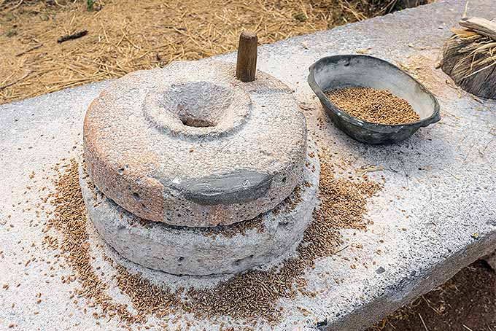
Traditional knowledge in different sectors
Engineering - Some Examples
Essence of Indian Traditional Knowledge
2020 . All rights reserved. For internal client use only.

Slide 32
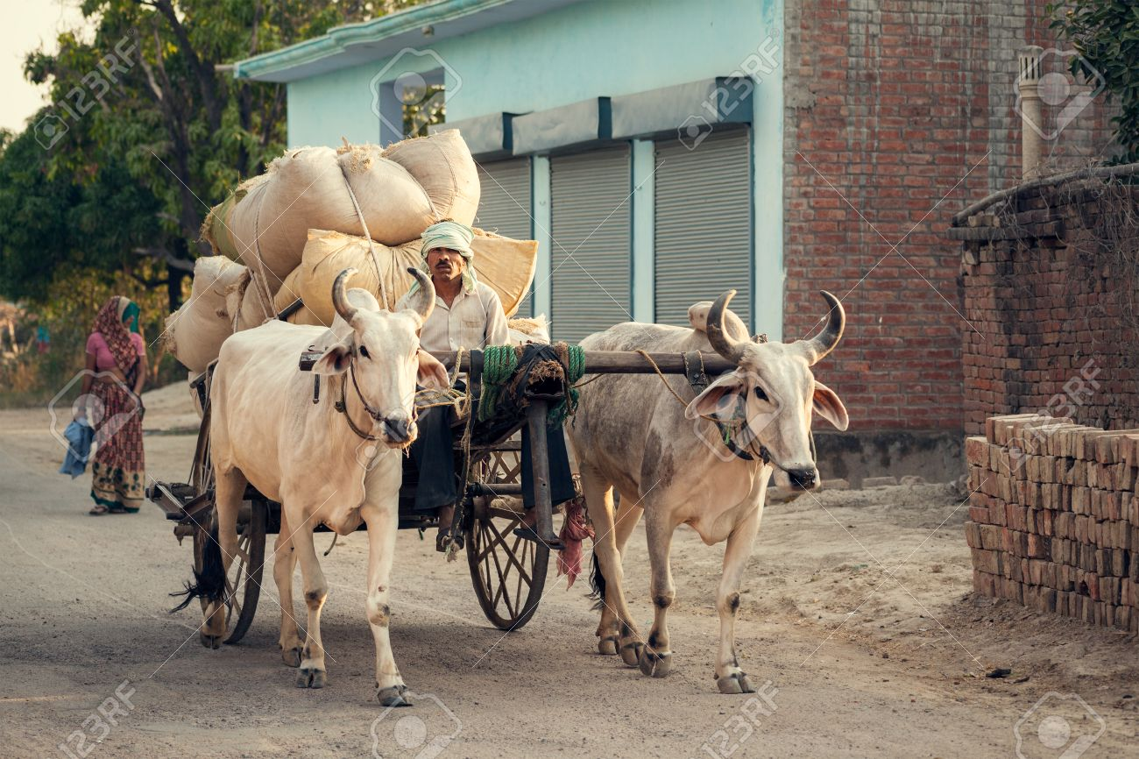
Traditional knowledge in different sectors
Engineering - Some Examples
Essence of Indian Traditional Knowledge
2020 . All rights reserved. For internal client use only.

Slide 33
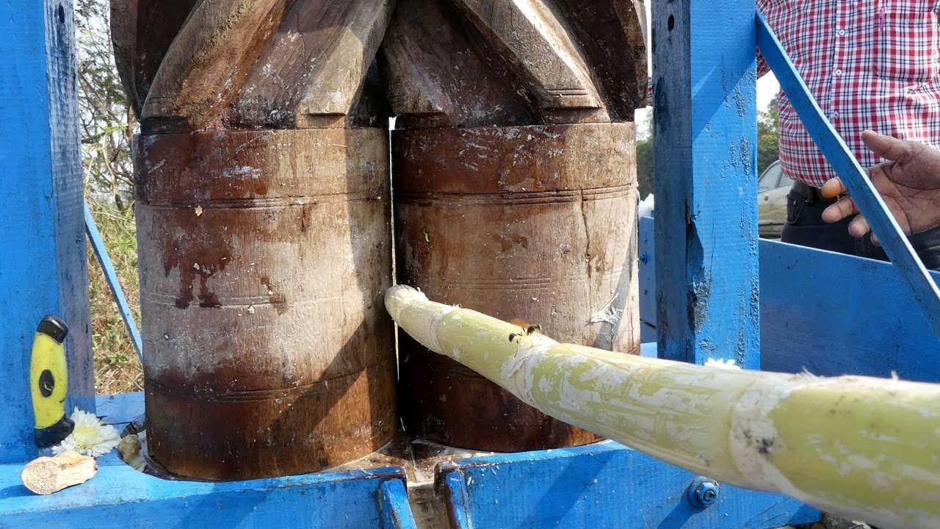
Traditional knowledge in different sectors
Engineering - Some Examples
Essence of Indian Traditional Knowledge
2020 . All rights reserved. For internal client use only.

Slide 34
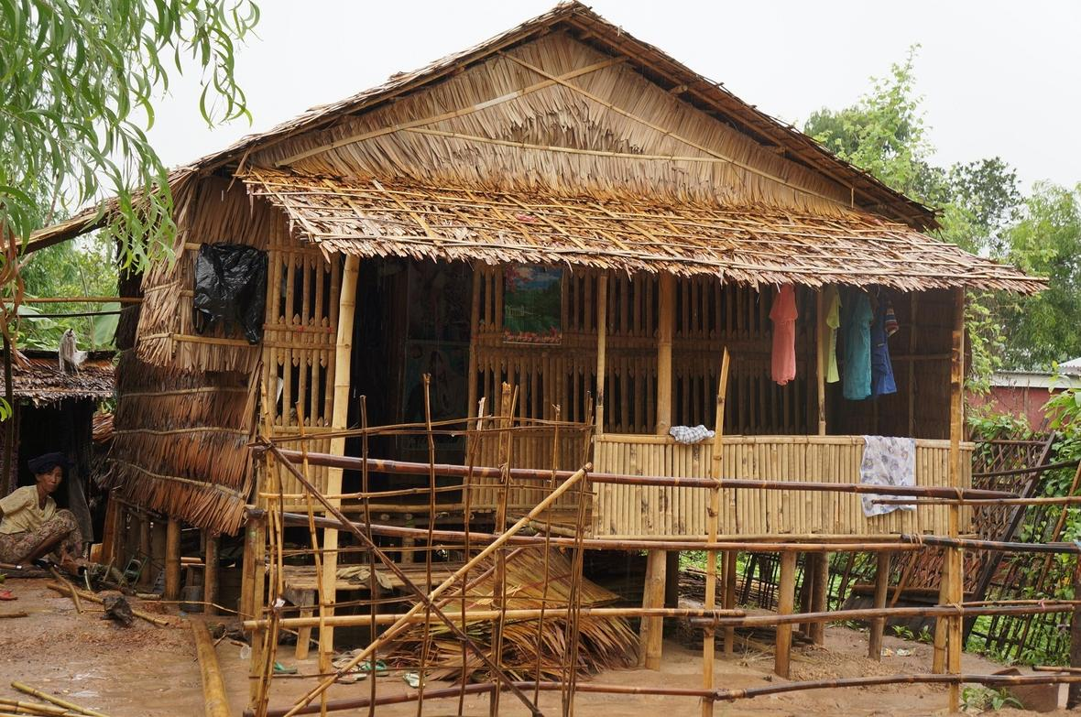
Traditional knowledge in different sectors
Engineering - Some Examples
Essence of Indian Traditional Knowledge
2020 . All rights reserved. For internal client use only.

Slide 35

Traditional knowledge in different sectors
Engineering - Some Examples
Essence of Indian Traditional Knowledge
2020 . All rights reserved. For internal client use only.

Slide 36
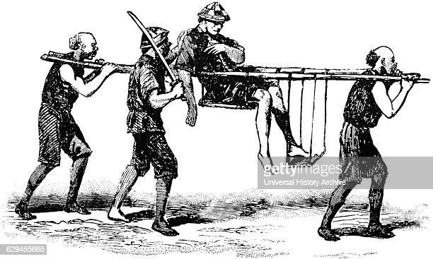
Traditional knowledge in different sectors
Engineering - Some Examples
Essence of Indian Traditional Knowledge
2020 . All rights reserved. For internal client use only.

Slide 37
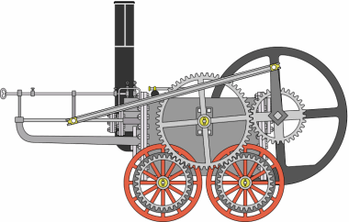
Traditional knowledge in different sectors
Engineering - Some Examples
Essence of Indian Traditional Knowledge
2020 . All rights reserved. For internal client use only.

Slide 38
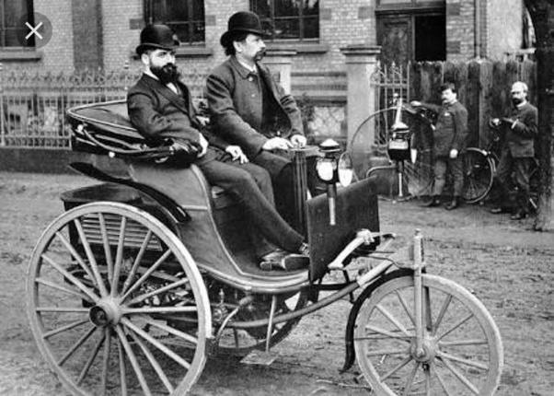
Traditional knowledge in different sectors
Engineering - Some Examples
Essence of Indian Traditional Knowledge
2020 . All rights reserved. For internal client use only.

Slide 39
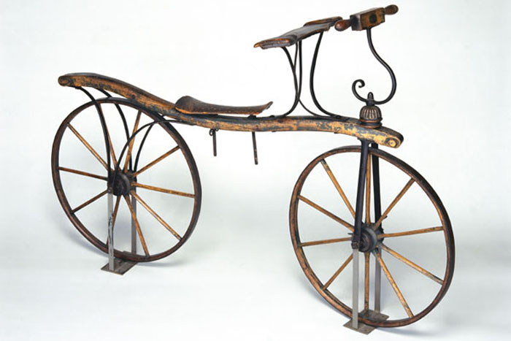
Traditional knowledge in different sectors
Engineering - Some Examples
Essence of Indian Traditional Knowledge
2020 . All rights reserved. For internal client use only.

Slide 40
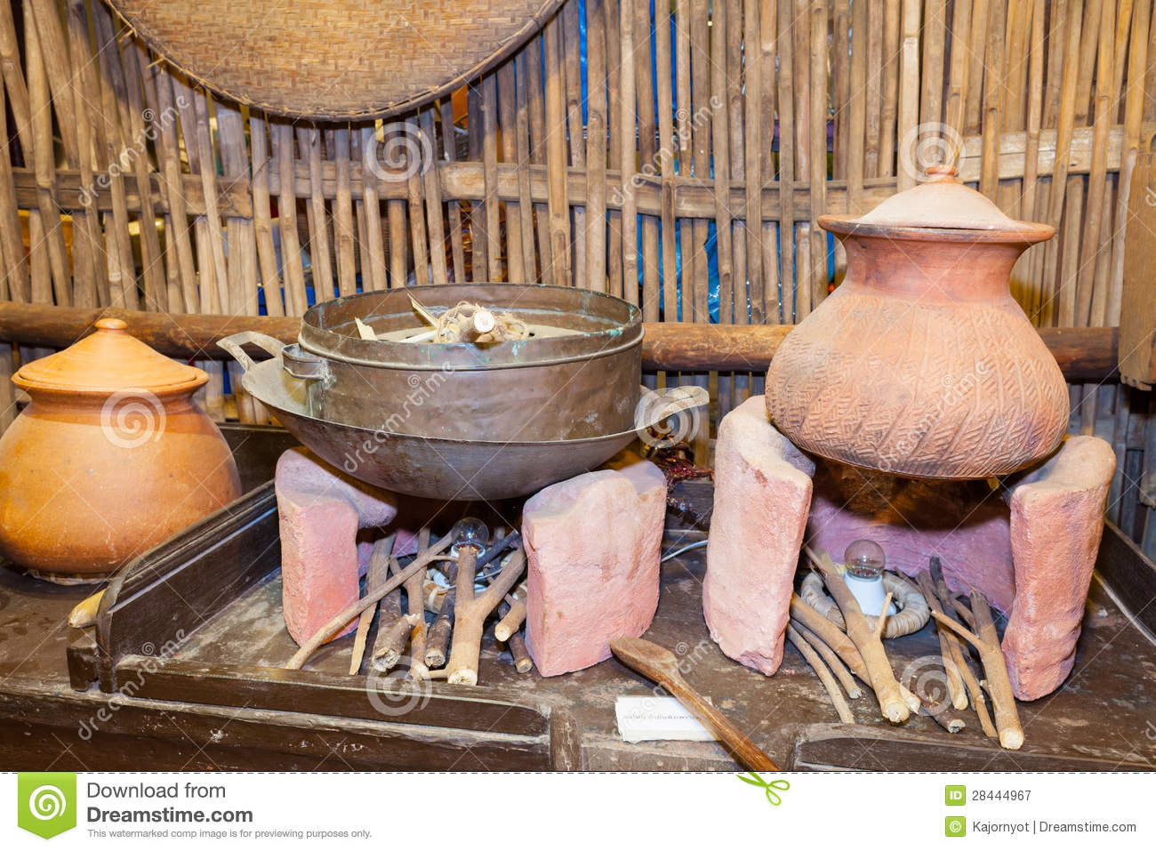
Traditional knowledge in different sectors
Engineering - Some Examples
Essence of Indian Traditional Knowledge
2020 . All rights reserved. For internal client use only.

Slide 41
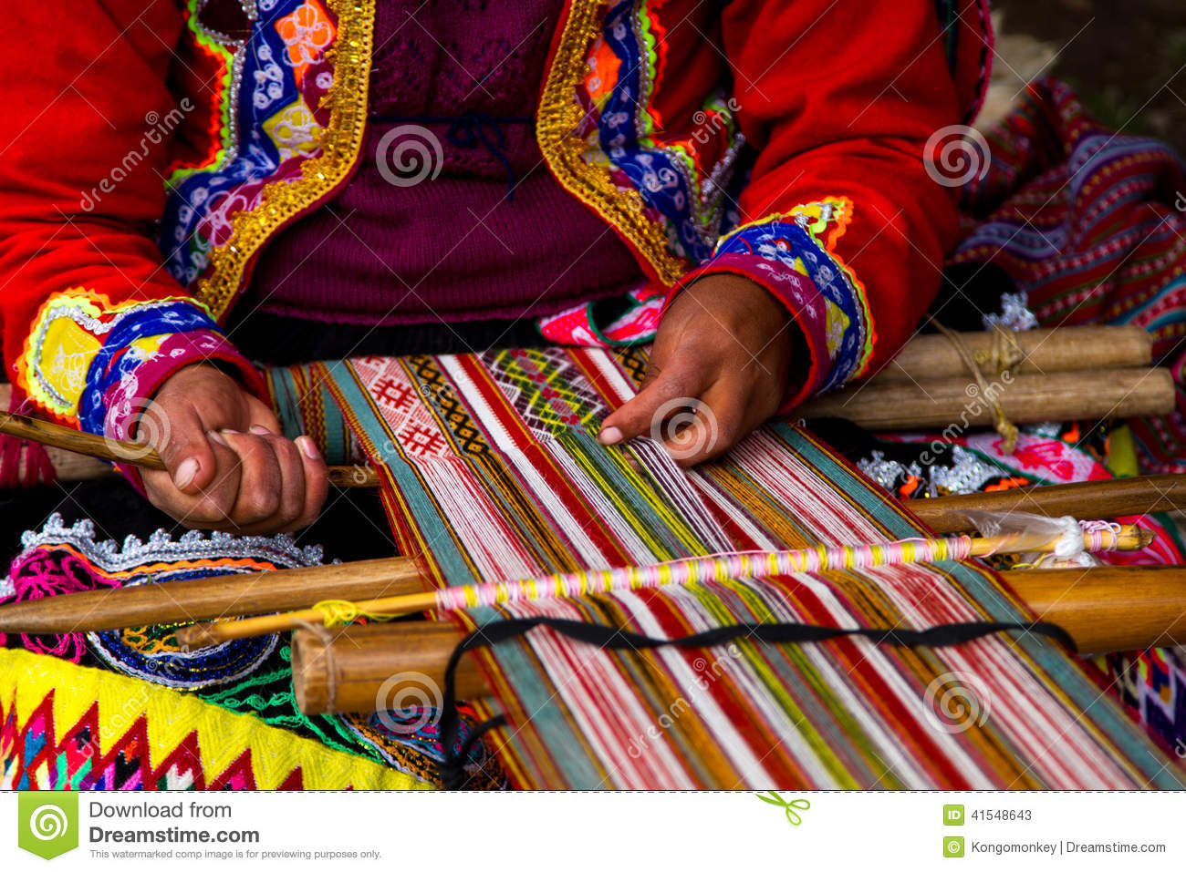
Traditional knowledge in different sectors
Engineering - Some Examples
Essence of Indian Traditional Knowledge
2020 . All rights reserved. For internal client use only.

Slide 42
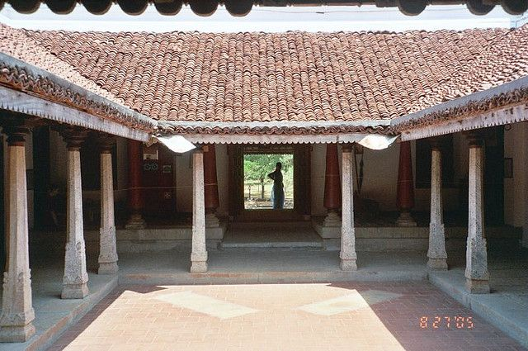
Traditional knowledge in different sectors
Engineering - Some Examples
Essence of Indian Traditional Knowledge
2020 . All rights reserved. For internal client use only.

Slide 43
Traditional knowledge in different sectors
Engineering - Some Examples
Essence of Indian Traditional Knowledge
Case Study – Indus Valley Civilization
2020 . All rights reserved. For internal client use only.

Slide 44
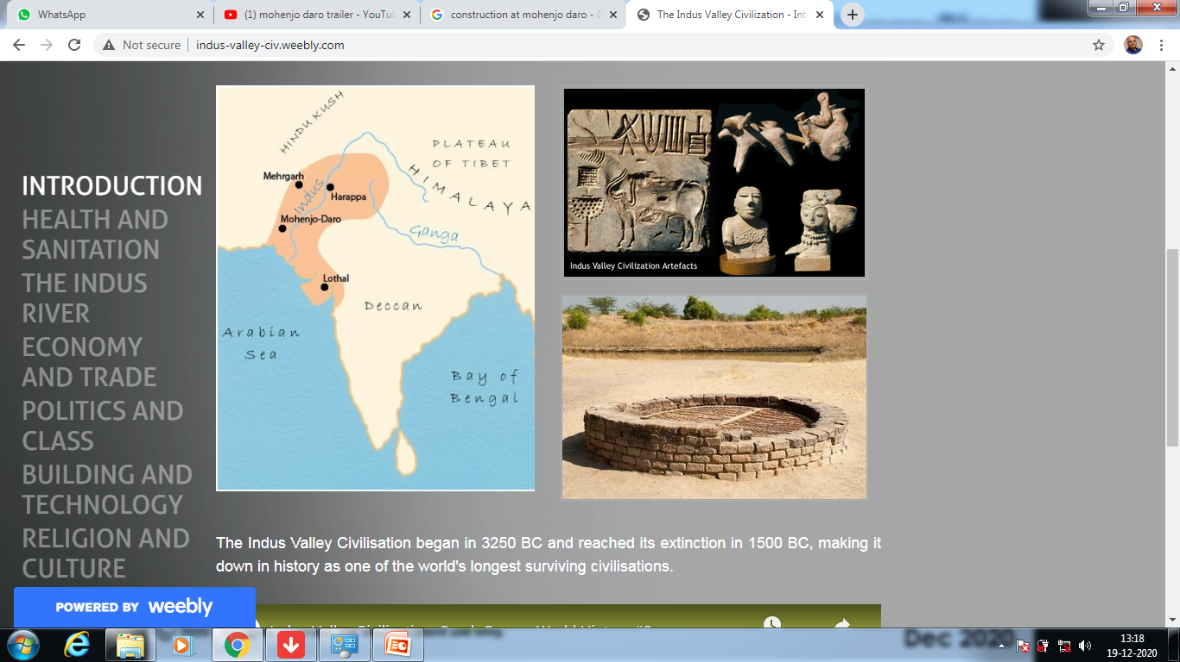
Traditional knowledge in different sectors
Engineering
Essence of Indian Traditional Knowledge
Case Study – Indus Valley Civilization
2020 . All rights reserved. For internal client use only.

Slide 45
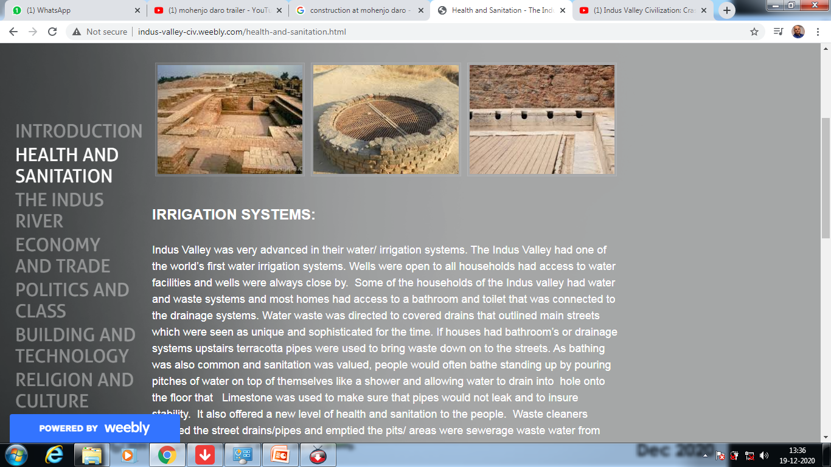
Traditional knowledge in different sectors
Engineering
Essence of Indian Traditional Knowledge
Case Study – Indus Valley Civilization
HEALTH & SANITATION
one of the world’s first water irrigation systems.
Wells were open to all households had access to water facilities
Advanced water and waste systems
Most homes had access to a bathroom and toilet
Connected drainage systems.
Water waste was directed to covered drains
terracotta pipes were used to bring waste down on to the streets.
people would often bathe standing up by pouring pitches of water on top of themselves like a shower and allowing water to drain into hole
Limestone was used to make sure that pipes would not leak & stability.
It also offered a new level of health and sanitation to the people.
Waste cleaners cleaned the street drains/pipes and emptied the pits/ areas were sewerage waste water from toilets was held

Slide 46
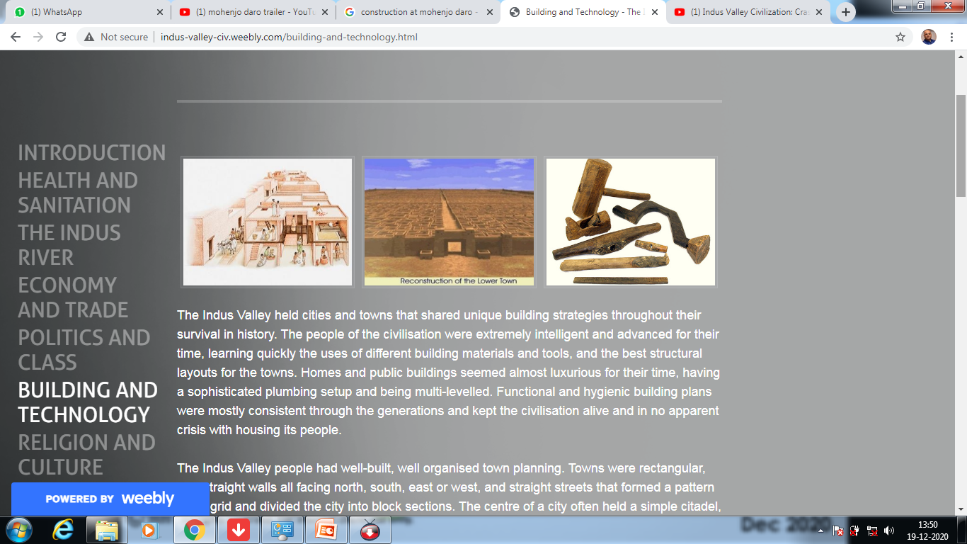
Traditional knowledge in different sectors
Engineering
Essence of Indian Traditional Knowledge
Case Study – Indus Valley Civilization
BUILDING & TECHNOLOGY
.The Indus Valley held cities and towns
shared unique building strategies throughout their survival in history.
people were extremely intelligent and advanced for their time, learning quickly the uses of different building materials and tools, and the best structural layouts for the towns.
Homes and public buildings seemed almost luxurious for their time, having a sophisticated plumbing setup and being multi-levelled.
Functional and hygienic building plans were mostly consistent through the generations and kept the civilisation alive and in no apparent crisis with housing its people.
2020 . All rights reserved. For internal client use only.

Slide 47
Traditional knowledge in different sectors
Engineering
Essence of Indian Traditional Knowledge
Case Study – Indus Valley Civilization
BUILDING & TECHNOLOGY
.The Indus Valley people had well-built, well organised town planning.
Towns were rectangular, with straight walls all facing north, south, east or west, and straight streets that formed a pattern like a grid and divided the city into block sections.
The centre of a city often held a simple citadel, a mound-like stronghold, where the people would go to for protection if ever under attack.
Housing was adequate and architecturally simple, yet outstanding.
From one to two to three storeys, whether in the lower or higher part of town, houses contained these following features.
continuous access to clean water from nearby wells & facilities,
including plumbing.

Slide 48
Traditional knowledge in different sectors
Engineering
Essence of Indian Traditional Knowledge
Case Study – Indus Valley Civilization
BUILDING & TECHNOLOGY
. The Indus Valley civilisation is thought to be the first with an urban sanitation system, again very advanced for their time.
There was a bathing room, and sometimes individual rooms for each person. All houses in a town were identical, and built together in courtyards. Connecting upper levels to lower levels were sets of brick stairs or sometimes ladders. The majority of houses were spacious and had flat roofs; however in poorer regions some houses had no roof at all and were exposed to all the weather.

Slide 49
Traditional knowledge in different sectors
Engineering
Essence of Indian Traditional Knowledge
Case Study – Indus Valley Civilization
BUILDING & TECHNOLOGY
The Great Granary is a mystery to today’s historians as to what its function was. Was it actually used to hold grains? Historians have been unable to find evidence to suggest that grains were once held there. It was thought to have been used as a place for farmers to store their crops, carts to load and unload, or even possibly as a temple. This massive building is made of wood on brick foundations and is over 60m long, with 6 large halls and arching doorways. The Great Granary is one of the significant buildings of the civilisation found in Mohenjo-Daro, along with the Great Bath.

Slide 50
Traditional knowledge in different sectors
Engineering
Essence of Indian Traditional Knowledge
Case Study – Indus Valley Civilization
BUILDING & TECHNOLOGY
The Great Bath is found in the middle of Mohenjo-Daro. It is believed to have been used as part of a religious bathing ritual for the people to gather together, and was very important to daily life. It had good drainage systems and was built with bricks that were held by tar and gypsum mortar so no water leaked. As can be seen, Mohenjo-Daro was the biggest and wealthiest city in the Indus Valley, with the most significant architectural constructions and the better sewerage systems. civilisation was.

Slide 51
Traditional knowledge in different sectors
Engineering
Essence of Indian Traditional Knowledge
Case Study – Indus Valley Civilization
BUILDING & TECHNOLOGY
In terms of building techniques, most structures were made of bricks. Some were larger than others, but each brick shared the same 4:2:1 ratio in dimensions, created by brick-makers. Soil-clay and water mixed to create a mud, which was pressed into any of the identical wooden moulds they used, and then baked hard in the hot sun or a kiln. When building, bricks were stuck together with a wet mud mortar. These bricks were a useful material for building as they were made of an abundant and renewable source and were very strong, allowing them to still stand today after more than 4000 years. The people of the Valley discovered new techniques of building with metals that were mined or imported, and from this successfully produced lead, copper, tin and bronze. From these metals, they constructed some tools (mostly made of flint – a type of rock) that helped them build other things. Clay was used in the process of toolmaking and became the substance that many pieces of cookware, pottery and sculptures. Some tools that were made with the metals are hammers, knives, needles, axes, razors, saws and others used for agriculture. The Indus Valley people are considered to be the first in many technological advancements, one of which being a developed measurement system. They had accurate methods of measuring length, mass and time by developing their own system of weights and rulers that were all identical. They were very intelligent and knowledgeable people who had a good understanding in mathematics and science. All their measurements were based on multiples of 16, like our metric system is based on multiples of 10. Having this sort of standard system across the whole civilisation prove how their specifically measured structures could withstand the years and not have faulted due to poor construction techniques. Along with constructing buildings and tools, they built boats and carts from imported wood to aid in their transport and trade. When the Indus River flooded the city, the mud brick structures would begin to soften and crumble. Archaeologists have discovered that when this happened, another whole city was just rebuilt on top of the previous. This left an amazing preservation of history where archaeologists have been able to observe the city reconstructions through time in chronological ordering. An interesting observation that was picked up was that each rebuilt city above another seemed to be slightly less advanced than the one below, meaning that as time progressed, structures were actually built increasingly poorer rather than more advanced like one would expect. The civilisation seemed to have not preserved all of their perfect building techniques through the generations, whether this is from a lack of communicating and passing on techniques or as a result of laziness. However, each rebuilt city was still a greatly advanced achievement in history for just how ancient this civilisation was.

Slide 52
Traditional knowledge in different sectors
Engineering
Essence of Indian Traditional Knowledge
Case Study – Indus Valley Civilization
BUILDING & TECHNOLOGY
The people of the Valley discovered new techniques of building with metals that were mined or imported, and from this successfully produced lead, copper, tin and bronze. From these metals, they constructed some tools (mostly made of flint – a type of rock) that helped them build other things. Clay was used in the process of toolmaking and became the substance that many pieces of cookware, pottery and sculptures. Some tools that were made with the metals are hammers, knives, needles, axes, razors, saws and others used for agriculture. The Indus Valley people are considered to be the first in many technological advancements, one of which being a developed measurement system. They had accurate methods of measuring length, mass and time by developing their own system of weights and rulers that were all identical. They were very intelligent and knowledgeable people who had a good understanding in mathematics and science. All their measurements were based on multiples of 16, like our metric system is based on multiples of 10. Having this sort of standard system across the whole civilisation prove how their specifically measured structures could withstand the years and not have faulted due to poor construction techniques. Along with constructing buildings and tools, they built boats and carts from imported wood to aid in their transport and trade. When the Indus River flooded the city, the mud brick structures would begin to soften and crumble. Archaeologists have discovered that when this happened, another whole city was just rebuilt on top of the previous. This left an amazing preservation of history where archaeologists have been able to observe the city reconstructions through time in chronological ordering. An interesting observation that was picked up was that each rebuilt city above another seemed to be slightly less advanced than the one below, meaning that as time progressed, structures were actually built increasingly poorer rather than more advanced like one would expect. The civilisation seemed to have not preserved all of their perfect building techniques through the generations, whether this is from a lack of communicating and passing on techniques or as a result of laziness. However, each rebuilt city was still a greatly advanced achievement in history for just how ancient this civilisation was.

Slide 53
Traditional knowledge in different sectors
Engineering
Essence of Indian Traditional Knowledge
Case Study – Indus Valley Civilization
BUILDING & TECHNOLOGY
The Indus Valley people are considered to be the first in many technological advancements, one of which being a developed measurement system. They had accurate methods of measuring length, mass and time by developing their own system of weights and rulers that were all identical. They were very intelligent and knowledgeable people who had a good understanding in mathematics and science. All their measurements were based on multiples of 16, like our metric system is based on multiples of 10. Having this sort of standard system across the whole civilisation prove how their specifically measured structures could withstand the years and not have faulted due to poor construction techniques. Along with constructing buildings and tools, they built boats and carts from imported wood to aid in their transport and trade. When the Indus River flooded the city, the mud brick structures would begin to soften and crumble. Archaeologists have discovered that when this happened, another whole city was just rebuilt on top of the previous. This left an amazing preservation of history where archaeologists have been able to observe the city reconstructions through time in chronological ordering. An interesting observation that was picked up was that each rebuilt city above another seemed to be slightly less advanced than the one below, meaning that as time progressed, structures were actually built increasingly poorer rather than more advanced like one would expect. The civilisation seemed to have not preserved all of their perfect building techniques through the generations, whether this is from a lack of communicating and passing on techniques or as a result of laziness. However, each rebuilt city was still a greatly advanced achievement in history for just how ancient this civilisation was.

Slide 54
Traditional knowledge in different sectors
Engineering
Essence of Indian Traditional Knowledge
Case Study – Indus Valley Civilization
BUILDING & TECHNOLOGY
When the Indus River flooded the city, the mud brick structures would begin to soften and crumble. Archaeologists have discovered that when this happened, another whole city was just rebuilt on top of the previous. This left an amazing preservation of history where archaeologists have been able to observe the city reconstructions through time in chronological ordering. An interesting observation that was picked up was that each rebuilt city above another seemed to be slightly less advanced than the one below, meaning that as time progressed, structures were actually built increasingly poorer rather than more advanced like one would expect. The civilisation seemed to have not preserved all of their perfect building techniques through the generations, whether this is from a lack of communicating and passing on techniques or as a result of laziness. However, each rebuilt city was still a greatly advanced achievement in history for just how ancient this civilisation was.

Slide 55
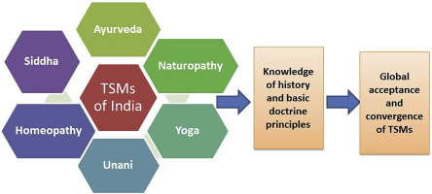
Traditional knowledge in different sectors
Medicine (TSM)
Essence of Indian Traditional Knowledge
2020 . All rights reserved. For internal client use only.

Slide 56
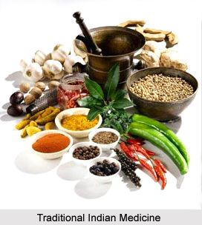
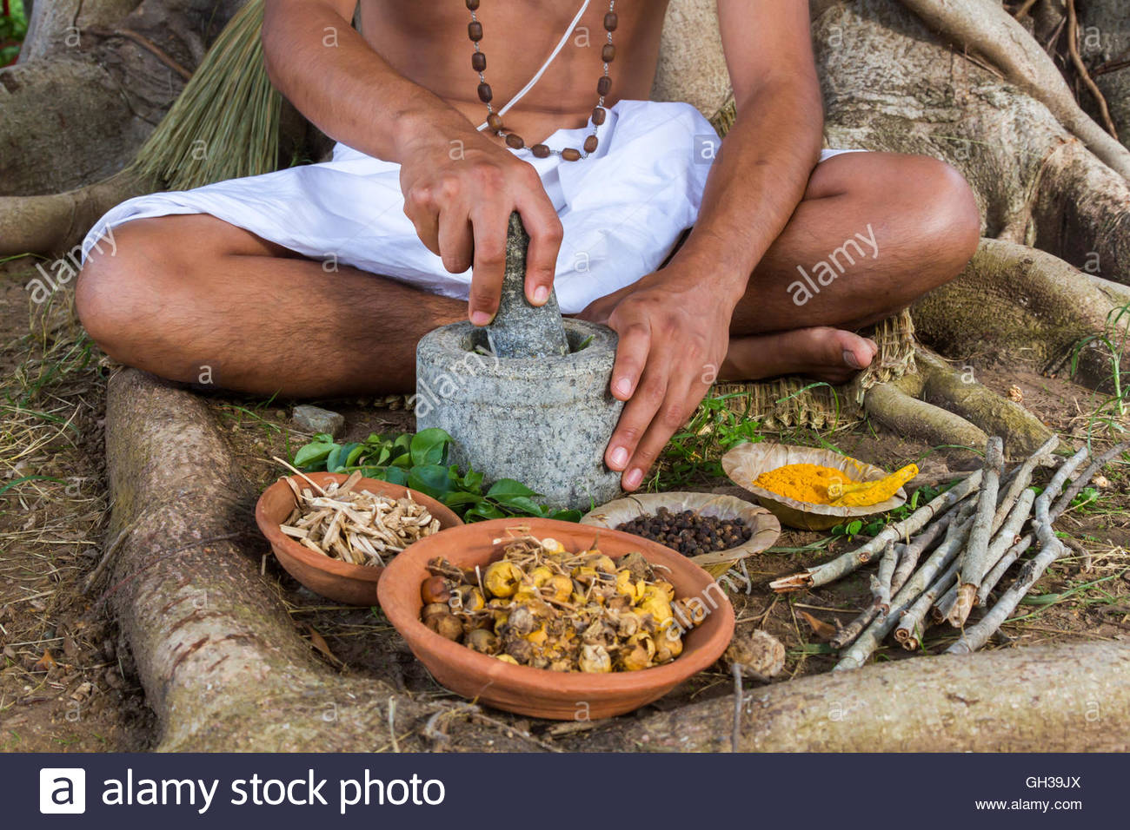
Traditional knowledge in different sectors
Medicine (TSM)
Essence of Indian Traditional Knowledge
2020 . All rights reserved. For internal client use only.

Slide 57
Traditional knowledge in different sectors
Medicine
Essence of Indian Traditional Knowledge
India is known for its traditional medicinal systems
Ayurveda, Siddha, and Unani. Medical systems are found mentioned even in the ancient Vedas and other scriptures.
Appeared and developed between 2500 and 500 BC in India
Ayurveda is the “science of life,”
Ancient Indian system of health care focused on views of man and his illness.
It has been pointed out that the positive health means metabolically well-balanced human beings.
Ayurveda is also called the “science of longevity” because it offers a complete system to live a long healthy life
2020 . All rights reserved. For internal client use only.

Slide 58
Traditional knowledge in different sectors
Medicine
Essence of Indian Traditional Knowledge
It offers programs to rejuvenate the body through diet and nutrition.
It offers treatment methods to cure many common diseases such as food allergies, which have few modern treatments
Ayurvedic nutrition is not a “magic bullet” system but requires the full participation of the patient to succeed.
It is an interactive system that is user-friendly and educational.
It teaches the patient to become responsible and self-empowered.
Ayurveda is not a nutritional system for those seeking an escape or excuse to further abuse their body or mind.
It is a system for empowerment, a system of freedom, and long life.
2020 . All rights reserved. For internal client use only.

Slide 59

Traditional knowledge in different sectors
Bio Technology
Essence of Indian Traditional Knowledge
Biotechnology is a broad area of biology, involving the use of living systems and organisms to develop or make products. Depending on the tools and applications, it often overlaps with related scientific fields
2020 . All rights reserved. For internal client use only.

Slide 60
Traditional knowledge in different sectors
Bio Technology
Essence of Indian Traditional Knowledge
Biodiversity conservation in Southeast Asia
https://link.springer.com/article/10.1007/s10531-010-9816-y
Governance related to the environment in the countries of Southeast Asia, to counter deforestation and the unsustainable exploitation of the region’s natural environment. Several factors have become important in triggering such debates.
1.The process of democratisation - NGOs and communities gettning heard
2. In some countries attempts at political and administrative decentralisation have been undertaken
3. Agricultural output, long taken for granted, is of renewed importance to national development planners after several countries experienced a food crisis and worrying price rises.
4. climate change and its potentially devastating impact on developing countries have entered the agenda.
5. From a legal perspective, a number of important international treaties linking trade and environmental issues were concluded during the 1990s and they are now entering the implementation stage or are under discussions for further amendments
2020 . All rights reserved. For internal client use only.

Slide 61
Traditional knowledge in different sectors
Bio Technology
Essence of Indian Traditional Knowledge
Biodiversity conservation in Southeast Asia
Convention on Biological Diversity (CBD)
CBD confirms the sovereign rights of States over their natural resources
The authority to determine access to genetic resources rests with the governments and is subject to national legislation
However, while most of the exchange of resources and benefits is framed as a relationship between state parties, “indigenous and local communities embodying traditional lifestyles relevant for the conservation and use of biological diversity” become relevant
The provision requires from state parties to “respect, preserve and maintain knowledge, innovations and practices” of such communities and to “promote their wider application with the approval and involvement of the holders of such knowledge, innovations and practices and encourage the equitable sharing of benefits arising from the utilization of such knowledge, innovations and practices
2020 . All rights reserved. For internal client use only.

Slide 62
Traditional knowledge in different sectors
Agriculture
Essence of Indian Traditional Knowledge
Agriculture in India is involved in domestic food supply, employment and cash income. ... There are six major themes related to Traditional Knowledge –
indigenous practices for water conservation
soil conservation,
plant protection,
unique agricultural practices,
cropping systems and
community level adaptation
2020 . All rights reserved. For internal client use only.

Slide 63
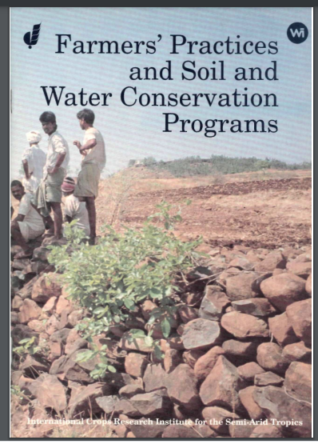
Traditional knowledge in different sectors
Agriculture – Soil and Water Conservation
Essence of Indian Traditional Knowledge
Internationa Crops Research Institute
Andhra Pradesh, 1991
2020 . All rights reserved. For internal client use only.

Slide 64
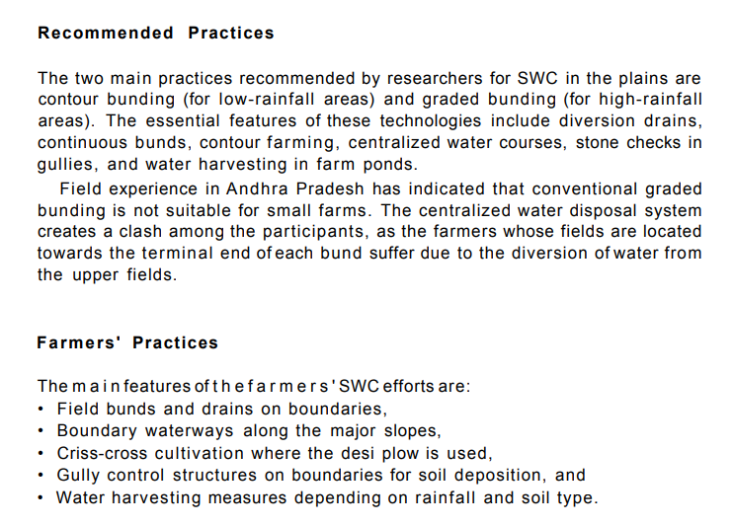
Traditional knowledge in different sectors
Agriculture – Indigenous practices for Soil
& Water Conservation
Essence of Indian Traditional Knowledge
2020 . All rights reserved. For internal client use only.

Slide 65
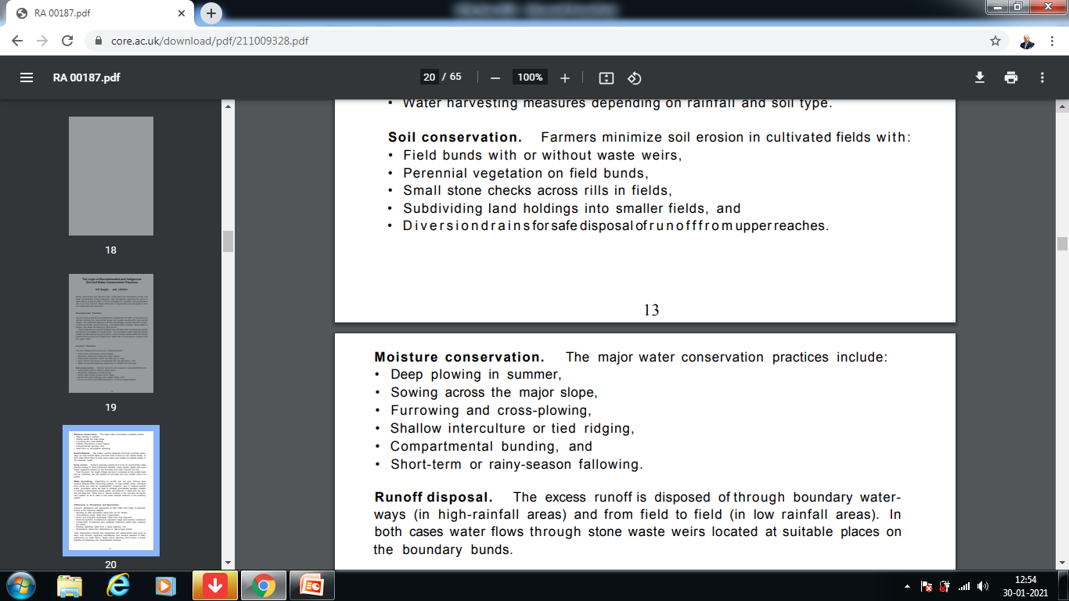
Traditional knowledge in different sectors
Agriculture – Indigenous practices for Soil
& Water Conservation
Essence of Indian Traditional Knowledge
2020 . All rights reserved. For internal client use only.

Slide 66
Traditional knowledge in different sectors
Agriculture – Plant Protection
Essence of Indian Traditional Knowledge
Crop protection is the science and practice of managing plant diseases, weeds and other pests (both vertebrate and invertebrate) that damage agricultural crops and forestry. ... Crop protection encompasses: Pesticide-based approaches such as herbicides, insecticides and fungicides.
Proper crop protection is important to produce higher quality crops with minimal wastage. This increase in productivity leads to less land, water and labour being required for food crops. With less land being used biodiversity is preserved and less greenhouse gases are emitted.
2020 . All rights reserved. For internal client use only.

Slide 67
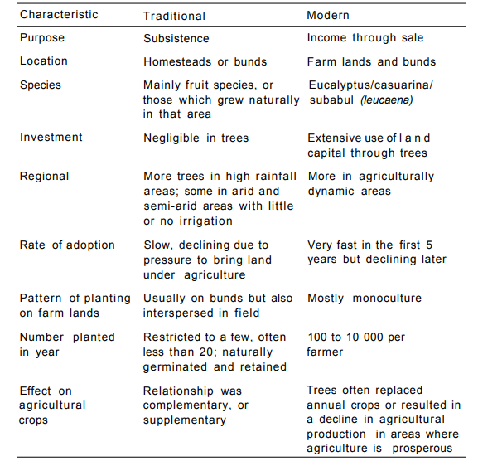
Traditional knowledge in different sectors
Agriculture – Plant Protection (Growing Trees)
Essence of Indian Traditional Knowledge
2020 . All rights reserved. For internal client use only.

Slide 68
Traditional knowledge in different sectors
Agriculture – Unique Agricultural Practices
Essence of Indian Traditional Knowledge
Unique agricultural practices arise in particular regions because of
physical characteristics of the land.
limited knowledge of alternatives.
distinctive cultural traits.
2020 . All rights reserved. For internal client use only.

Slide 69
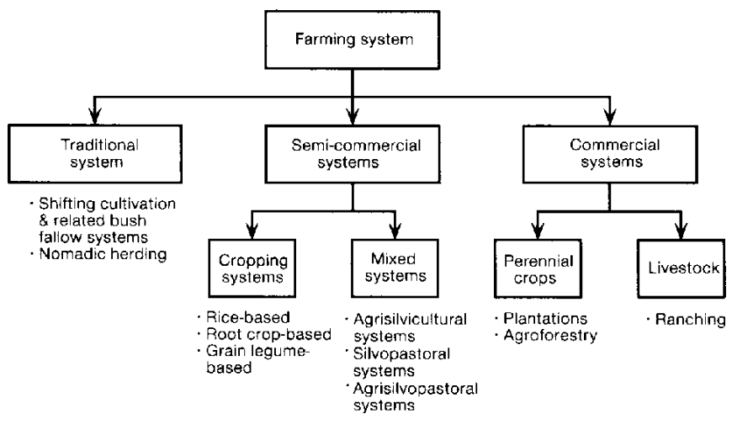
Traditional knowledge in different sectors
Agriculture – Unique Agricultural Practices
Essence of Indian Traditional Knowledge
2020 . All rights reserved. For internal client use only.

Slide 70
Traditional knowledge in different sectors
Agriculture – Unique Agricultural Practices
#1 - Subsistence Farming
Essence of Indian Traditional Knowledge
Majority of farmers in the country practise subsistence farming.
It is characterised by small and scattered land holdings and use of primitive tools.
As the farmers are poor, they do not use fertilisers and high yielding variety of seeds in their fields to the extent they should do.
Facilities like electricity and irrigation are generally not available to them.
Features of Subsistence Farming:
The whole family works on the farm
Most of the work is done manually
The farms are small
Tradition methods of farming are followed
Yield is not very high
Most of the yield is consumed by the family with very little surplus for the family
2020 . All rights reserved. For internal client use only.

Slide 71
Traditional knowledge in different sectors
Agriculture – Unique Agricultural Practices
Shifting Agriculture
Essence of Indian Traditional Knowledge
In this type of agriculture, first of all a piece of forest land is cleared by felling trees and burning of trunks and branches.
After the land is cleared, crops are grown for two to three years and then the land is abandoned as the fertility of the soil decreases.
The farmers then move to new areas and the process is repeated.
Dry paddy, maize, millets and vegetables are the crops commonly grown in this type of farming.
2020 . All rights reserved. For internal client use only.

Slide 72
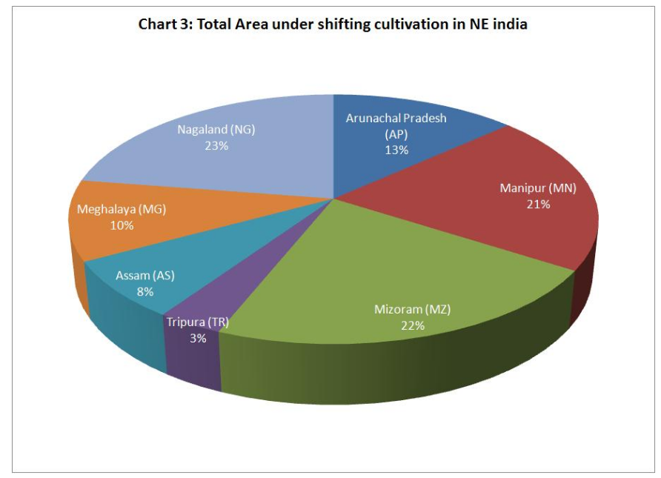
Traditional knowledge in different sectors
Agriculture – Unique Agricultural Practices
Essence of Indian Traditional Knowledge
2020 . All rights reserved. For internal client use only.

Slide 73
Traditional knowledge in different sectors
Agriculture – Unique Agricultural Practices
Plantation Farming
Essence of Indian Traditional Knowledge
Plantation farming is bush or tree farming. It was introduced by the British in the 19th century.
It is a single crop farming of rubber, tea, coffee, cocoa, spices, coconut and fruit crops like apples, grapes, oranges, etc.
It is capital intensive and demands good managerial ability, technical know-how, sophisticated machinery, fertilisers, irrigation, and transport facilities.
Plantation agriculture is an export-oriented agriculture. Most of the crops grown in plantation agriculture have a life cycle of more than two years.
Natural rubber, coconuts, oil palm, tea, cocoa, and coffee are all tree crops and take years to mature, but afterwards they are productive for long periods.
Plantation agriculture is confined within tropical areas, i.e., both sides of the equator. Plantations exist on every continent possessing a tropical climate.
Some of the plantations like tea, coffee and rubber have a processing factory within the farm itself or close to it.
This type of agriculture has developed in hilly areas of north-eastern India, sub-Himalayan West Bengal and in Nilgiri, Anamalai and Cardamom hills in peninsular India.
2020 . All rights reserved. For internal client use only.

Slide 74
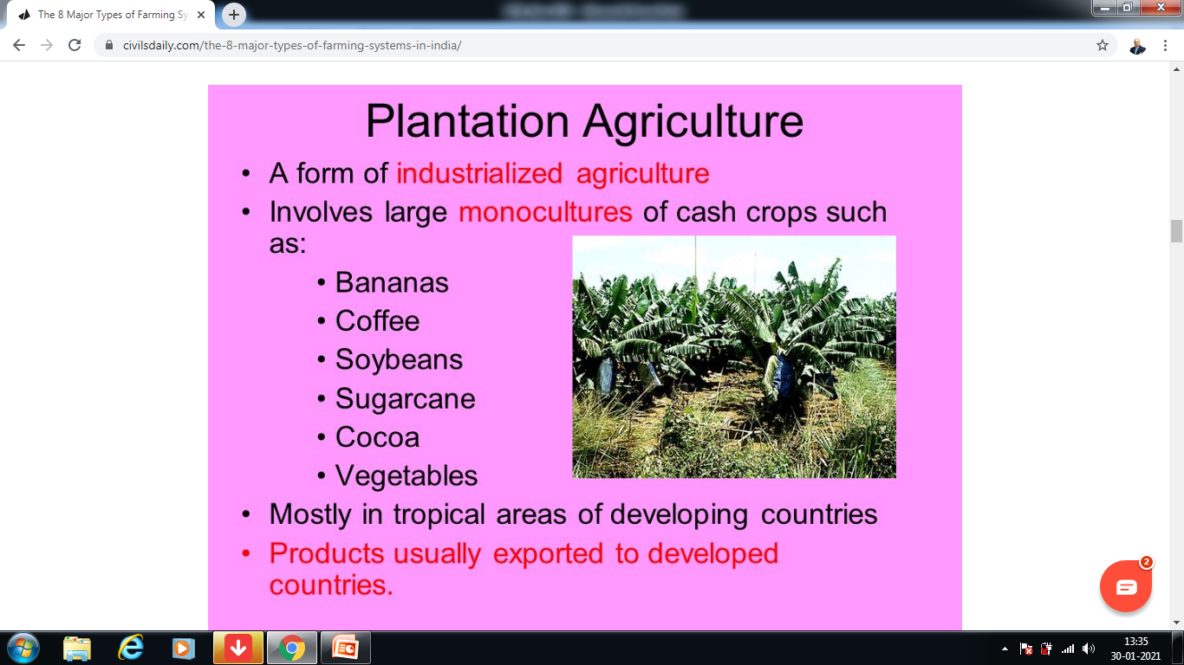
Traditional knowledge in different sectors
Agriculture – Unique Agricultural Practices
Essence of Indian Traditional Knowledge
2020 . All rights reserved. For internal client use only.

Slide 75
Traditional knowledge in different sectors
Agriculture – Unique Agricultural Practices
Intensive Farming
Essence of Indian Traditional Knowledge
In areas where irrigation has been possible, the farmers use fertilisers and pesticides on large scale. They have also brought their land under high yielding variety of seeds. They have mechanised agriculture by introducing machines in various processes of farming.
Also known as industrial agriculture, it is characterized by a low fallow ratio and higher use of inputs such as capital and labour per unit land area. This is in contrast to traditional agriculture in which the inputs per unit land are lower.
2020 . All rights reserved. For internal client use only.

Slide 76
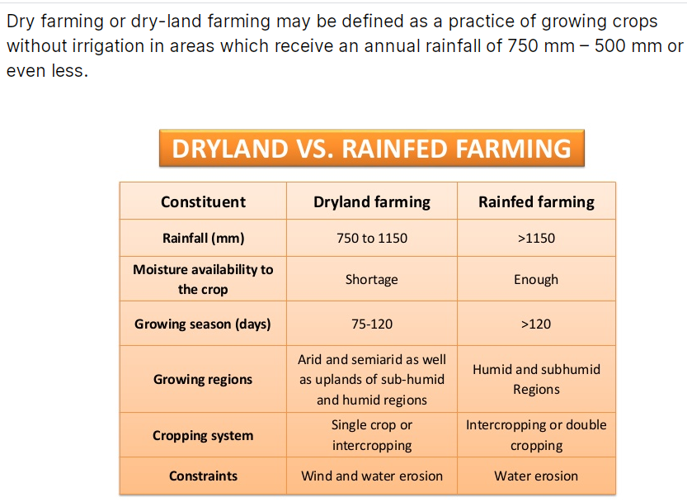
Traditional knowledge in different sectors
Agriculture – Unique Agricultural Practices
Dry Farming
Essence of Indian Traditional Knowledge
2020 . All rights reserved. For internal client use only.

Slide 77
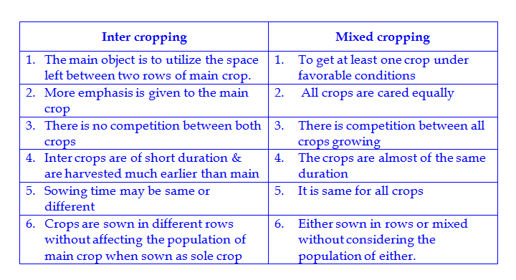
Traditional knowledge in different sectors
Agriculture – Unique Agricultural Practices
Mixed and Multiple Farming
Essence of Indian Traditional Knowledge
2020 . All rights reserved. For internal client use only.

Slide 78
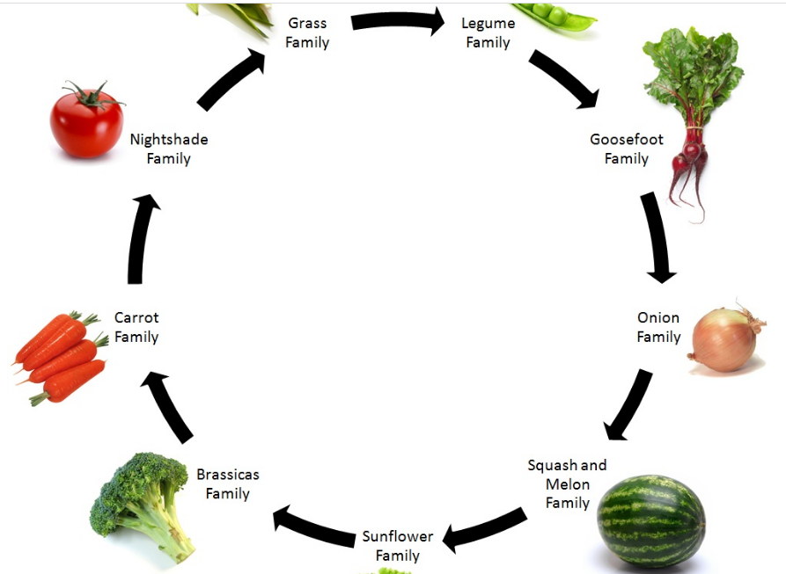
Traditional knowledge in different sectors
Agriculture – Unique Agricultural Practices
Crop Rotation
Essence of Indian Traditional Knowledge
2020 . All rights reserved. For internal client use only.

Slide 79
Traditional knowledge in different sectors
Agriculture – Unique Agricultural Practices
Crop Rotation
Essence of Indian Traditional Knowledge
This refers to growing of number of Crops one after the other in a fixed rotation to maintain the fertility of the soil. The rotation of crops may be complete in a year in some of the areas while it may involve more than one year’s time is others.
Pulses or any leguminous crop is grown after the cereal crops.
Legumes have the ability of fixing nitrogen to the soil.
Highly fertilizer intensive crops like sugarcane or tobacco are rotated with cereal crops.
The selection of crops for rotation depends upon the local soil conditions and the experience and the understanding of the farmers.
2020 . All rights reserved. For internal client use only.

Slide 80
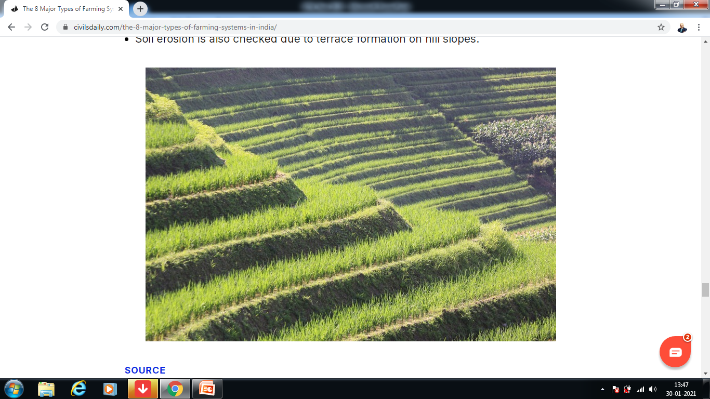
Traditional knowledge in different sectors
Agriculture – Unique Agricultural Practices
Terrace Farming
Essence of Indian Traditional Knowledge
2020 . All rights reserved. For internal client use only.

Slide 81
Traditional knowledge in different sectors
Agriculture – Cropping Systems
Essence of Indian Traditional Knowledge
The term cropping system refers to the crops, crop sequences and management techniques used on a particular agricultural field over a period of years. It includes all spatial and temporal aspects of managing an agricultural system.
2020 . All rights reserved. For internal client use only.

Slide 82
Traditional knowledge in different sectors
Agriculture – Cropping Systems
Essence of Indian Traditional Knowledge
Monocropping: Example Planting Wheat year after year in the same field. Monocropping is when the field is used to grow only one crop season after season.
Disadvantages: it is difficult to maintain cover on the soil; it encourages pests, diseases and weeds; and it can reduce the soil fertility and damage the soil structure.
2020 . All rights reserved. For internal client use only.

Slide 83
Traditional knowledge in different sectors
Agriculture – Cropping Systems
Essence of Indian Traditional Knowledge
Crop Rotation: Example Planting maize one year, and beans the next. Crop Rotation means changing the type of crops grown in the field each season or each year (or changing from crops to fallow).
Crop rotation is a key principle of agriculture conservation because it improves the soil structure and fertility, and because it helps control weeds, pests and diseases.
2020 . All rights reserved. For internal client use only.

Slide 84
Traditional knowledge in different sectors
Agriculture – Cropping Systems
Essence of Indian Traditional Knowledge
Sequential Cropping: Example- Planting maize in the long rains, then beans during the short rains. Sequential Cropping involves growing two crops in the same field, one after the other in the same year.
In some places, the rainy season is long enough to grow two crops: either two main crops, or one main crop followed by a cover crop.
Growing Crops two crops may also be possible if there are two rainy seasons, or if there is enough moisture left in the soil to grow a second crop.
2020 . All rights reserved. For internal client use only.

Slide 85
Traditional knowledge in different sectors
Agriculture – Cropping Systems
Essence of Indian Traditional Knowledge
Intercropping: Examples- Planting alternating rows of maize and beans, or growing a cover crop in between the cereal rows. Intercropping means growing two or more crops in the same field at the same time.
2020 . All rights reserved. For internal client use only.

Slide 86
Traditional knowledge in different sectors
Agriculture – Cropping Systems
Essence of Indian Traditional Knowledge
Mixed Intercropping: Distribution of the seeds of both the crops, or dibbling the seeds without any row arrangement. This process is called mixed intercropping. It is easy to do but makes weeding, fertilization and harvesting difficult. Individual plants may compete with each other because they are too close together.
Planting the main crop in rows and then spreading the seeds of the intercrop (such as a cover crop).
2020 . All rights reserved. For internal client use only.

Slide 87
Traditional knowledge in different sectors
Agriculture – Cropping Systems
Essence of Indian Traditional Knowledge
Row Intercropping: Planting both the main crop and the intercrop in rows. This is called row intercropping. The rows make weeding and harvesting easier than with mixed intercropping.
2020 . All rights reserved. For internal client use only.

Slide 88
Traditional knowledge in different sectors
Agriculture – Cropping Systems
Essence of Indian Traditional Knowledge
Stir Cropping: Example Planting alternating strips of maize, soybean and finger millet. Stir Cropping involves planting broad strips of several crops in the field. Each strip is 3–9 m wide. On slopes, the strips can be laid out along the contour to prevent erosion. The next year, the farmer can rotate crops by planting each strip with a different crop.
Advantages:
It produces a variety of crops, the legume improves the soil fertility, and rotation helps reduce pest and weed problems.
The residues from one strip can be used as soil cover for neighbouring strips.
At the same time, strip cropping avoids some of the disadvantages of intercropping: managing the single crop within the strip is easy, and competition between the crops is reduced.
2020 . All rights reserved. For internal client use only.

Slide 89
Traditional knowledge in different sectors
Agriculture – Cropping Systems
Essence of Indian Traditional Knowledge
Relay Cropping: Example- Planting maize, then sowing beans between the maize rows four weeks later.
Relay Cropping the process of growing one crop, then planting another crop (usually a cover crop) in the same field before harvesting the first. This helps avoid competition between the main crop and the intercrop. It also uses the field for a longer time, since the cover crop usually continues to grow after the main crop is harvested
2020 . All rights reserved. For internal client use only.

Slide 90
Traditional knowledge in different sectors
Agriculture – Cropping Systems
Essence of Indian Traditional Knowledge
Monocropping: Example Planting Wheat year after year in the same field. Monocropping is when the field is used to grow only one crop season after season.
Disadvantages: it is difficult to maintain cover on the soil; it encourages pests, diseases and weeds; and it can reduce the soil fertility and damage the soil structure.
Crop Rotation: Example Planting maize one year, and beans the next. Crop Rotation means changing the type of crops grown in the field each season or each year (or changing from crops to fallow).
Crop rotation is a key principle of agriculture conservation because it improves the soil structure and fertility, and because it helps control weeds, pests and diseases.
Sequential Cropping: Example- Planting maize in the long rains, then beans during the short rains. Sequential Cropping involves growing two crops in the same field, one after the other in the same year.
In some places, the rainy season is long enough to grow two crops: either two main crops, or one main crop followed by a cover crop.
Growing Crops two crops may also be possible if there are two rainy seasons, or if there is enough moisture left in the soil to grow a second crop.
Intercropping: Examples- Planting alternating rows of maize and beans, or growing a cover crop in between the cereal rows. Intercropping means growing two or more crops in the same field at the same time.
Mixed Intercropping: Distribution of the seeds of both the crops, or dibbling the seeds without any row arrangement. This process is called mixed intercropping. It is easy to do but makes weeding, fertilization and harvesting difficult. Individual plants may compete with each other because they are too close together.
Planting the main crop in rows and then spreading the seeds of the intercrop (such as a cover crop).
Row Intercropping: Planting both the main crop and the intercrop in rows. This is called row intercropping. The rows make weeding and harvesting easier than with mixed intercropping.
Stir Cropping: Example Planting alternating strips of maize, soybean and finger millet. Stir Cropping involves planting broad strips of several crops in the field. Each strip is 3–9 m wide. On slopes, the strips can be laid out along the contour to prevent erosion. The next year, the farmer can rotate crops by planting each strip with a different crop.
Advantages:
It produces a variety of crops, the legume improves the soil fertility, and rotation helps reduce pest and weed problems.
The residues from one strip can be used as soil cover for neighbouring strips.
At the same time, strip cropping avoids some of the disadvantages of intercropping: managing the single crop within the strip is easy, and competition between the crops is reduced.
Relay Cropping: Example- Planting maize, then sowing beans between the maize rows four weeks later.
Relay Cropping the process of growing one crop, then planting another crop (usually a cover crop) in the same field before harvesting the first. This helps avoid competition between the main crop and the intercrop. It also uses the field for a longer time, since the cover crop usually continues to grow after the main crop is harvested
2020 . All rights reserved. For internal client use only.

